Slide 1
Major functions of the spark als api

Slide 2
hello!
We are Group 5
Cathy
Jiayue
Michael
Xinyi

Slide 3
1.
pyspark.mllib.recommendation module
Notes:
https://spark.apache.org/docs/latest/api/python/pyspark.mllib.html#module-pyspark.mllib.recommendation

Slide 4
1 MatrixFactorizationModel
class pyspark.mllib.recommendation.MatrixFactorizationModel
A matrix factorisation model trained by regularized alternating least-squares.

Slide 5
1 MatrixFactorizationModel
classmethod load(sc, path)
predict(user, product)
predictAll(user_product)
productFeatures( )
userFeatures( )
property rank
recommendProducts(user, num)
recommendProductsForUsers(num)
recommendUsers(product, num)
recommendUsersForProducts(num)

Slide 6
2 ALS
class pyspark.mllib.recommendation.ALS
Alternating Least Squares matrix factorization

Slide 7
2 ALS
Parameters
ratings – RDD of Rating or (userID, productID, rating) tuple.
rank – Number of features to use (also referred to as the number of latent factors).
iterations – Number of iterations of ALS. (default: 5)
lambda – Regularization parameter. (default: 0.01)
blocks – Number of blocks used to parallelize the computation. A value of -1 will use an auto-configured number of blocks. (default: -1)
nonnegative – A value of True will solve least-squares with nonnegativity constraints. (default: False)
seed – Random seed for initial matrix factorization model. A value of None will use system time as the seed. (default: None)

Slide 8
2 ALS
classmethod train(ratings, rank, iterations=5, lambda_=0.01, blocks=-1, nonnegative=False, seed=None)
Train a matrix factorization model given an RDD of ratings by users for a subset of products. The ratings matrix is approximated as the product of two lower-rank matrices of a given rank (number of features). To solve for these features, ALS is run iteratively with a configurable level of parallelism.

Slide 9
2 ALS
classmethod trainImplicit(ratings, rank, iterations=5, lambda_=0.01, blocks=-1, alpha=0.01, nonnegative=False, seed=None)
Train a matrix factorization model given an RDD of ‘implicit preferences’ of users for a subset of products. The ratings matrix is approximated as the product of two lower-rank matrices of a given rank (number of features). To solve for these features, ALS is run iteratively with a configurable level of parallelism.

Slide 10
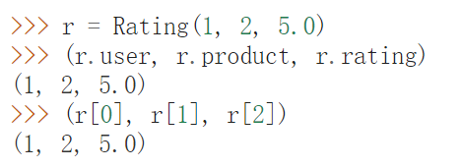
3 Rating
class pyspark.mllib.recommendation.Rating
Represents a (user, product, rating) tuple.

Slide 11
Recap
Prepare data
Create a model
Predictions
Evaluations
Save

Slide 12
THANK YOU!
ANY QUESTION?

